Slide 1
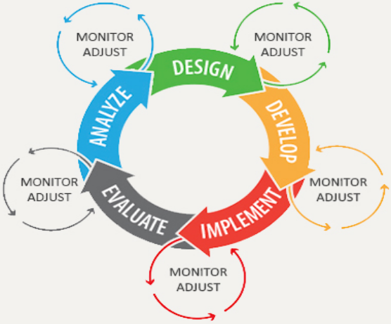
Unit 12.2 - Program Design
Prepared by: Koh Kian Hua

Slide 2
Objectives
After completing this unit, students should be able to:
Describe the purpose of a structure chart.
Construct a structure chart for a given problem.
Use a structure chart to decompose a problem into sub-tasks and express the parameters passed between the various modules / procedures / functions which are part of the algorithm design
Derive equivalent pseudocode from a structure chart
Show understanding of the purpose of state-transition diagrams to document an algorithm

Slide 3
Program Design
Purpose and Use of Structured Charts
A structure chart is a modelling tool used in program design to decompose a problem into a set of sub-tasks.
It shows the hierarchy or structure of the different modules and how they connect and interact with each other.
Each module is represented by a box and the parameters passed to and from the modules are shown by arrows pointing towards the module receiving the parameter.

Slide 4
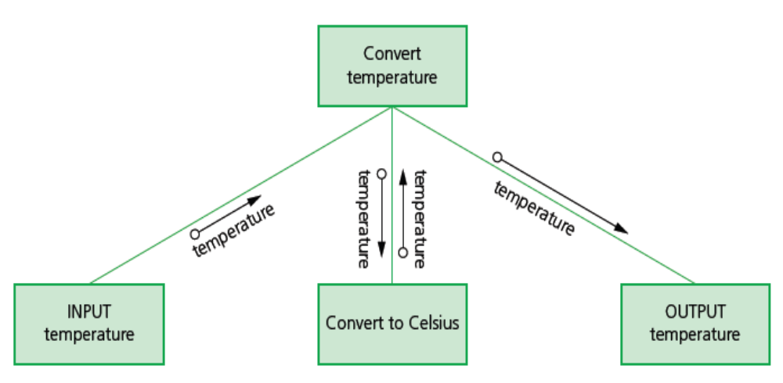
Program Design
Purpose and Use of Structured Charts
Figure of a structure chart for converting a temperature from Fahrenheit to Celsius

Slide 5
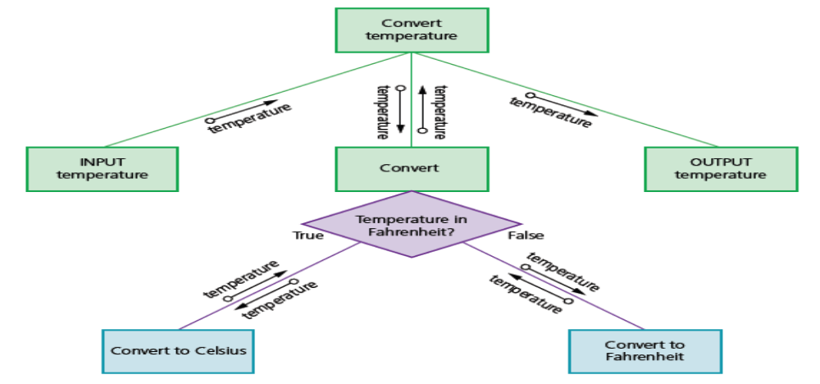
Program Design
Purpose and Use of Structured Charts
Structure charts can also show selection.
The temperature conversion task could be extended to either convert from Fahrenheit to Celsius or vice versa using the diamond shaped box to show a condition that could be true or false.

Slide 6
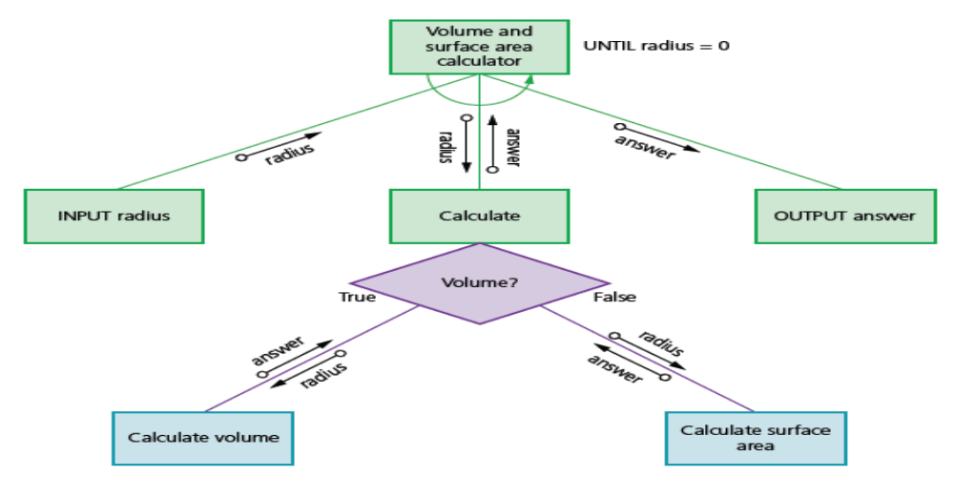
Program Design
Purpose and Use of Structured Charts
Once a structure chart has been completed, it can be used to derive a pseudocode algorithm.

Slide 7
Program Design
Deriving Pseudo Codes from Structured Charts
To derive the pseudo code from the structure chart in the previous slide, we can create an identifier table.
Identifier Name | Description
radius | Stores radius input
answer | Stores result of calculation
pi | Constant set to 3.142

Slide 8
Program Design
Deriving Pseudo Codes from Structured Charts
Then, we declare constants and variables in pseudocode. We also identify two of the variables required from the parameters shown in the structure diagram.
DECLARE radius : REAL
DECLARE answer : REAL
CONSTANT pi ← 3.142

Slide 9
Program Design
Deriving Pseudo Codes from Structured Charts
Provide pseudocode for the modules shown in the structure diagram.
As Calculate volume and Calculate surface area provide the answer to a calculation, these can be defined as functions..
FUNCTION calculateVolume (radius:real) RETURNS real
RETURN (4 / 3) * pi * radius * radius * radius
ENDFUNCTION
FUNCTION calculateSurfaceArea (radius:real) RETURNS real
RETURN 4 * pi * radius * radius
ENDFUNCTION

Slide 10
Program Design
Deriving Pseudo Codes from Structured Charts
The input and output modules could be defined as procedures.
PROCEDURE inputRadius
OUTPUT "Please enter the radius of the sphere "
INPUT radius
WHILE radius < 0 DO
OUTPUT "Please enter a positive number "
INPUT radius
ENDWHILE
ENDPROCEDURE
PROCEDURE outputAnswer
OUTPUT answer
ENDPROCEDURE

Slide 11
Program Design
State Transition Diagrams
A finite state machine (FSM) is a mathematical model of a machine that can be in one of a fixed set of possible states.
One state is changed to another by an external input, this is called a transition.
A diagram showing the behaviour of an FSM is called a state-transition diagram.
State-transition diagrams show the conditions needed for an event or events that will cause a transition to occur.
It also shows the outputs or actions carried out as the result of that transition.

Slide 12
Program Design
State Transition Diagrams
State-transition diagrams can be constructed as follows:
» States are represented as nodes (circles).
» Transitions are represented as interconnecting arrows.
» Events are represented as labels on the arrows.
» Conditions can be specified in square brackets after the event label.
» The initial state is indicated by an arrow with a black dot.
» A stopped state is indicated by a double circle.

Slide 13
Program Design
State Transition Diagrams (Example)
The algorithm for unlocking a door using a three-digit entry code can be represented by a state-transition diagram.
If the door is unlocked with a three digit entry code, the lock can be in four states:
  locked and waiting for the input of the first digit
  waiting for the input of the second digit
  waiting for the input of the third digit
  unlocked.

Slide 14
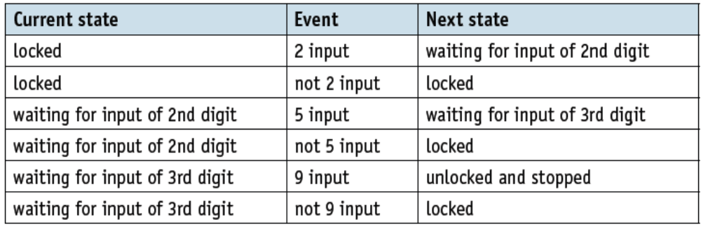
Program Design
State Transition Diagrams (Example)
If an incorrect digit is input, then the door returns to the locked state.
The algorithm halts when the door is unlocked.
A state-transition table showsevery state, each possible input and the state after the input.
The state transition table for a door with the entry code 259 is shown below.

Slide 15
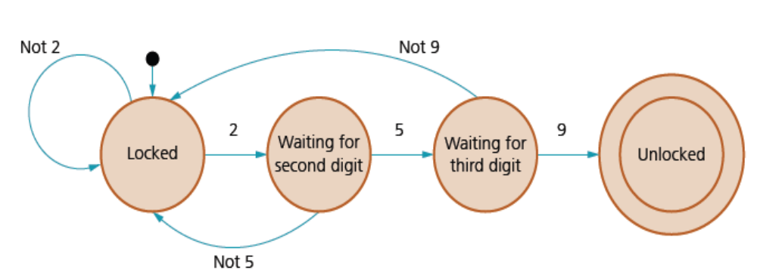
Program Design
State Transition Diagrams (Example)
The state-transition diagram for a door with the entry code 259 is shown below:

Slide 16
Program Design
Class Activity
1) Briefly describe the purpose of Structure Charts in prorgram (software) design.
2) What is a State Transition Diagram ? How can it be used for program design ?

